Slide 1
Machine Learning DASC 522
Tree-based Regression & Classification
Dr. Torrey Wagner

Slide 2
Overview
Big Picture
Regression Trees
Classification Trees
Regularization via Pruning
Trees vs. Linear Models
Advantages and Disadvantages of Trees

Slide 3
Overview
Big Picture
Regression Trees
Classification Trees
Regularization via Pruning
Trees vs. Linear Models
Advantages and Disadvantages of Trees

Slide 4
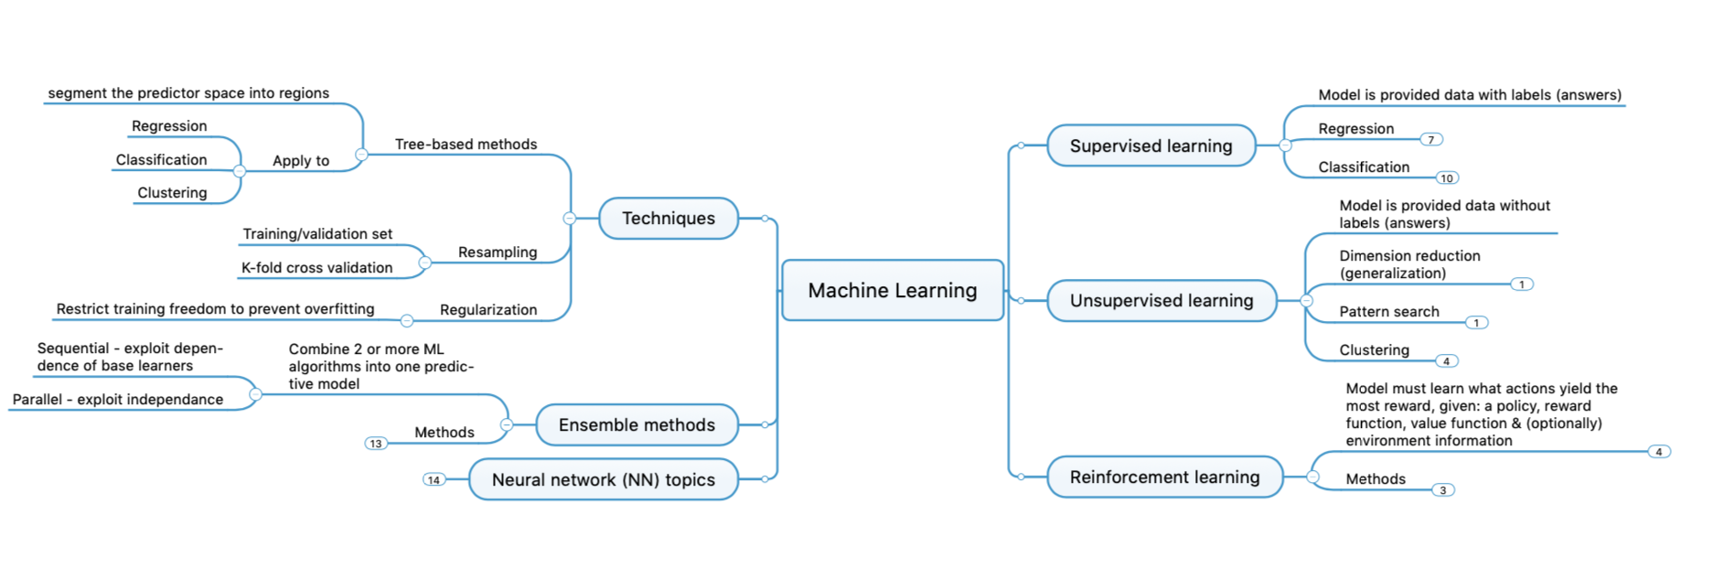
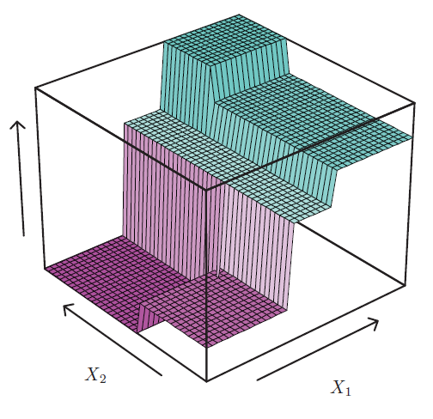
Concept Map
R₅
R₄
R₃
R₂
R₁

Slide 5
Overview
Big Picture
Regression Trees
Classification Trees
Regularization via Pruning
Trees vs. Linear Models
Advantages and Disadvantages of Trees
Model Building with Python Examples

Slide 6
Prediction as Partitioning the feature space
One way to make predictions in a regression problem is to divide the feature space into distinct regions, say R₁, R₂,…,R_{k}
Then for each observation that falls in a particular region (say R_{j}) we make the same prediction
The value of the prediction should be influenced by the response variables of the observations which are members of the region
Slide from Dr. Brett Borghetti, AFIT/ENG CSCE 623 Statistical Machine Learning course, 2019SP

Slide 7
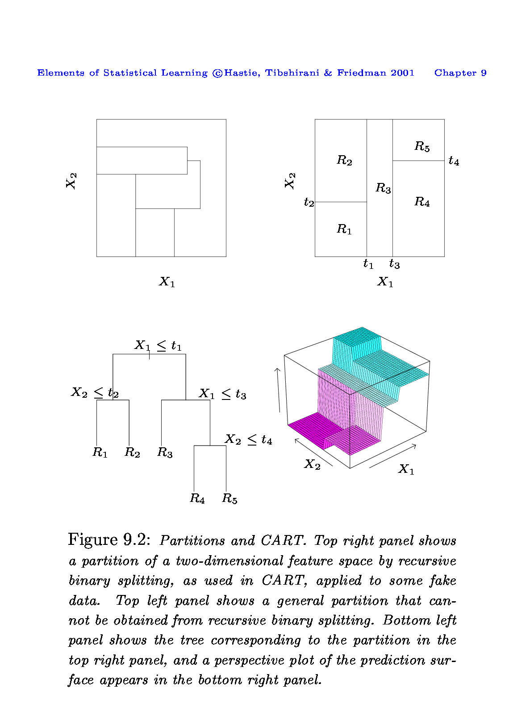
Multi-feature example
two predictors and five distinct regions
Depending on which region our new X comes from we would make one of five possible predictions for Y.
y = 27
y = 0
y = 23
X₂
y = 20
y = 8
X₁
Slide from Dr. Brett Borghetti, AFIT/ENG CSCE 623 Statistical Machine Learning course, 2019SP

Slide 8
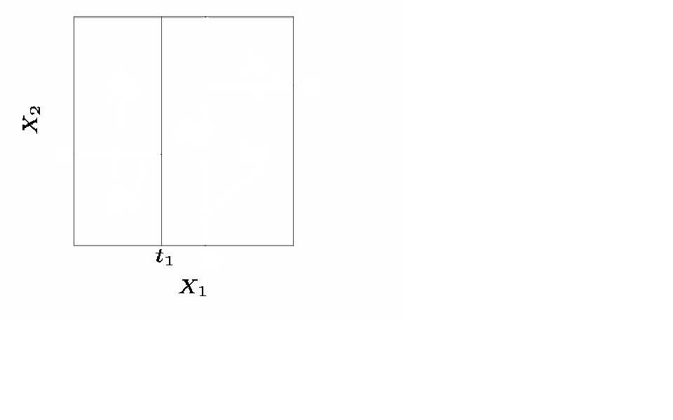
Splitting the X Variable
First split on X₁=t₁
Slide from Dr. Brett Borghetti, AFIT/ENG CSCE 623 Statistical Machine Learning course, 2019SP

Slide 9
Splitting the X Variable
First split on X₁=t₁
If X₁<t₁, split on X₂=t₂
Slide from Dr. Brett Borghetti, AFIT/ENG CSCE 623 Statistical Machine Learning course, 2019SP

Slide 10
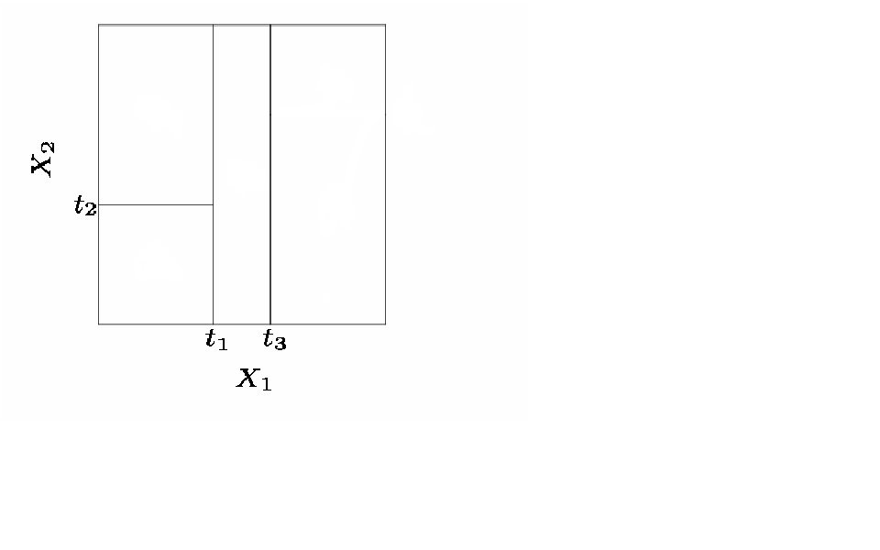
Splitting the X Variable
First split on X₁=t₁
If X₁<t₁, split on X₂=t₂
If X₁>t₁, split on X₁=t₃
If X₁>t₃, split on X₂=t₄
Slide from Dr. Brett Borghetti, AFIT/ENG CSCE 623 Statistical Machine Learning course, 2019SP

Slide 11
Splitting the X Variable
First split on X₁=t₁
If X₁<t₁, split on X₂=t₂
If X₁>t₁, split on X₁=t₃
If X₁>t₃, split on X₂=t₄
Slide from Dr. Brett Borghetti, AFIT/ENG CSCE 623 Statistical Machine Learning course, 2019SP

Slide 12
Splitting the X Variable
R₅
R₄
R₃
y
R₂
R₁
Partitions can be represented with a tree structure.
This provides a very simple way to interpret the model
Slide from Dr. Brett Borghetti, AFIT/ENG CSCE 623 Statistical Machine Learning course, 2019SP

Slide 13
Another way of visualizing the decision tree…
R₁
R₂
R₃
Slide from Dr. Brett Borghetti, AFIT/ENG CSCE 623 Statistical Machine Learning course, 2019SP

Slide 14
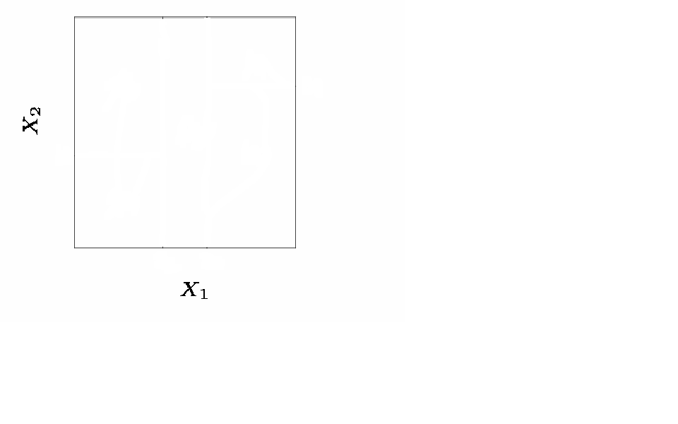
Where to Split?
Consider splitting a region into two regions, X_{j}>s and X_{j}≤s for all possible real values of s and feature indices j.
One option: Choose the s and j that results in the lowest MSE on the training data.
Slide from Dr. Brett Borghetti, AFIT/ENG CSCE 623 Statistical Machine Learning course, 2019SP

Slide 15
Where to Split Next?
Suppose the optimal split was on X₁ at point t₁.
Now we repeat the process looking for the next best split except that we must also consider whether to split the first region or the second region up.
Again the criteria is smallest MSE.
Slide from Dr. Brett Borghetti, AFIT/ENG CSCE 623 Statistical Machine Learning course, 2019SP

Slide 16
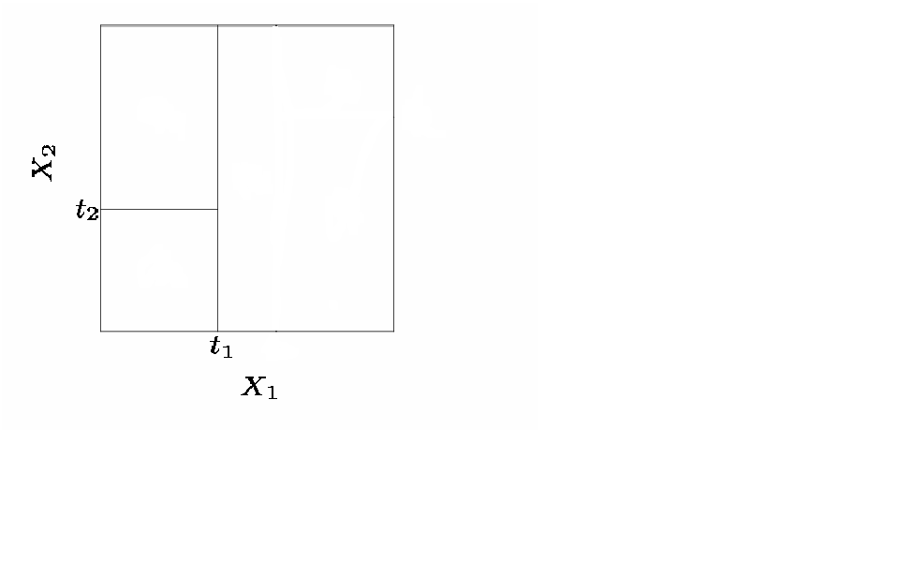
Where to Split?
Here the optimal split was the left region on X₂ at point t₂.
This process continues until our regions have too few observations to continue e.g. all regions have 5 or fewer points.
Slide from Dr. Brett Borghetti, AFIT/ENG CSCE 623 Statistical Machine Learning course, 2019SP

Slide 17
Python Examples
ISLR - Hitter dataset
HOML – Math function

Slide 18
Overview
Big Picture
Regression Trees
Classification Trees
Regularization via Pruning
Trees vs. Linear Models
Advantages and Disadvantages of Trees

Slide 19
Growing a Classification Tree
A classification makes a prediction for a categorical Y
For each region (or node) we predict the most common category among the training data within that region
The tree is grown (i.e. the splits are chosen) in exactly the same way as with a regression tree except we need a different criteria to optimize
There are several possible different criteria to use such as the “gini index” and “cross-entropy” but the easiest one to think about is to minimize the error rate.
R₅
R₄
R₃
R₂
R₁
Slide from Dr. Brett Borghetti, AFIT/ENG CSCE 623 Statistical Machine Learning course, 2019SP

Slide 20
Example: Orange Juice Preference
Training Error Rate = 14.75%
Test Error Rate = 23.6%

Slide 21
Python Examples
ISLR – Heart attack dataset
HOML – Iris dataset

Slide 22
Overview
Big Picture
Regression Trees
Classification Trees
Regularization via Pruning
Trees vs. Linear Models
Advantages and Disadvantages of Trees

Slide 23
Improving Tree Accuracy
A large tree (i.e. one with many terminal nodes) may tend to overfit the training data since you could continue to split until each observation had its own leaf node.
Generally, we can improve estimated test set accuracy by “pruning” the tree i.e. cutting off some of the terminal nodes.
How do we know how far back to prune the tree? We use cross validation to see which subtree has the lowest validation error rate.
Slide from Dr. Brett Borghetti, AFIT/ENG CSCE 623 Statistical Machine Learning course, 2019SP

Slide 24
Pruning Example: Baseball Players’ Salaries
The minimum cross validation error occurs at a tree size of 3
Slide from Dr. Brett Borghetti, AFIT/ENG CSCE 623 Statistical Machine Learning course, 2019SP

Slide 25
Pruning Example: Baseball Players’ Salaries
Slide from Dr. Brett Borghetti, AFIT/ENG CSCE 623 Statistical Machine Learning course, 2019SP

Slide 26
Pruning Example: Orange Juice Preference
Pruned Tree
CV Tree Error Rate = 22.5%
Full Tree Training Error Rate = 14.75%
Full Tree Test Error Rate = 23.6%
Slide from Dr. Brett Borghetti, AFIT/ENG CSCE 623 Statistical Machine Learning course, 2019SP

Slide 27
Overview
Big Picture
Regression Trees
Classification Trees
Regularization via Pruning
Trees vs. Linear Models
Advantages and Disadvantages of Trees

Slide 28
Trees vs. Linear Models
Which model is better?
If the relationship between the predictors and response is linear, then classical linear models such as linear regression would outperform regression trees
On the other hand, if the relationship between the predictors is non-linear, then decision trees can outperform linear approaches
Slide from Dr. Brett Borghetti, AFIT/ENG CSCE 623 Statistical Machine Learning course, 2019SP

Slide 29
Trees vs. Linear Model: Classification Example
Top row: the true decision boundary is linear
Left: linear model (good)
Right: decision tree
Bottom row: the true decision boundary is non-linear
Left: linear model
Right: decision tree (good)
Slide from Dr. Brett Borghetti, AFIT/ENG CSCE 623 Statistical Machine Learning course, 2019SP

Slide 30
Overview
Big Picture
Regression Trees
Classification Trees
Regularization via Pruning
Trees vs. Linear Models
Advantages and Disadvantages of Trees

Slide 31
Pros and Cons of Decision Trees
Pros:
Trees are very easy to interpret (probably even easier than linear regression)
Trees can be plotted graphically, and are easily interpreted even by non-expert
Tress handle both classification and regression problems
Cons:
Trees don’t have the same prediction accuracy as some of the more complicated approaches in ML
Slide from Dr. Brett Borghetti, AFIT/ENG CSCE 623 Statistical Machine Learning course, 2019SP

Slide 32
Trees & Forest Summary
Trees and Forests offer non-linear machine learning models which can answer both prediction and inference questions
There are many alternative tree & forest model architectures
Each architecture has a set of hyperparameters to determine
Cross-validation should be used to make model and hyperparameter decisions… but this increases the computational cost of finding a good model
Slide from Dr. Brett Borghetti, AFIT/ENG CSCE 623 Statistical Machine Learning course, 2019SP

Slide 33
Bagging, Random Forests, Boosting
Chapter 08 (part 02)

Slide 34
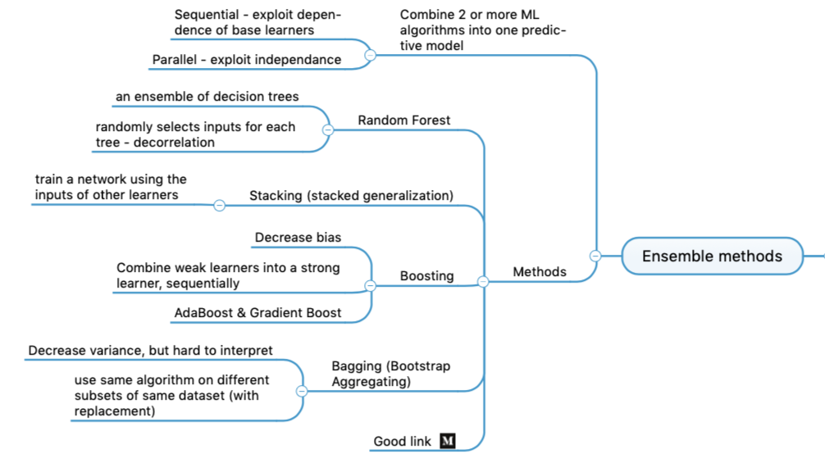
Ensemble Methods

